Slide 1

DAY 1
HANDS - ON

Slide 2
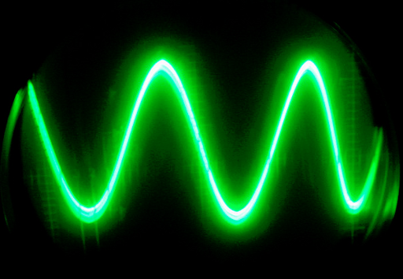
GENERATIVE
MODEL
SINE WAVE

Slide 3
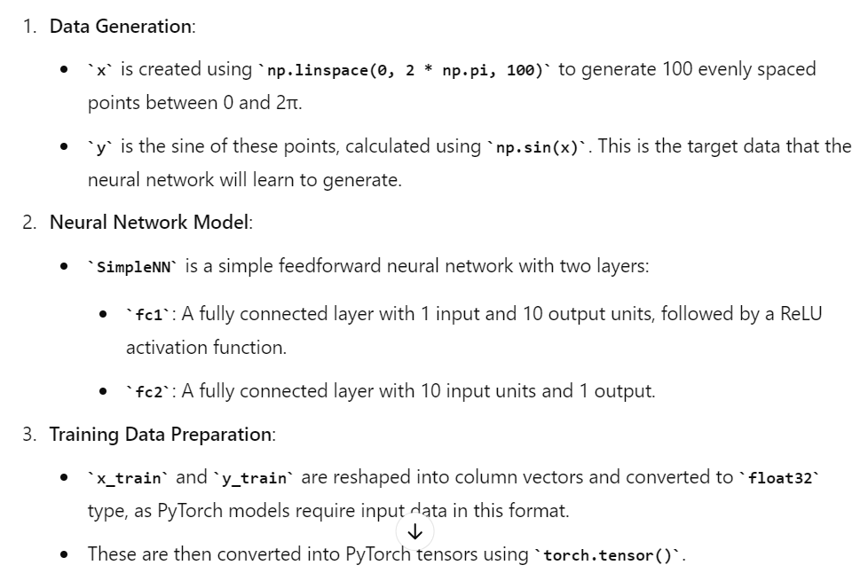
SINE WAVE WITH GENERATIVE MODEL

Slide 4
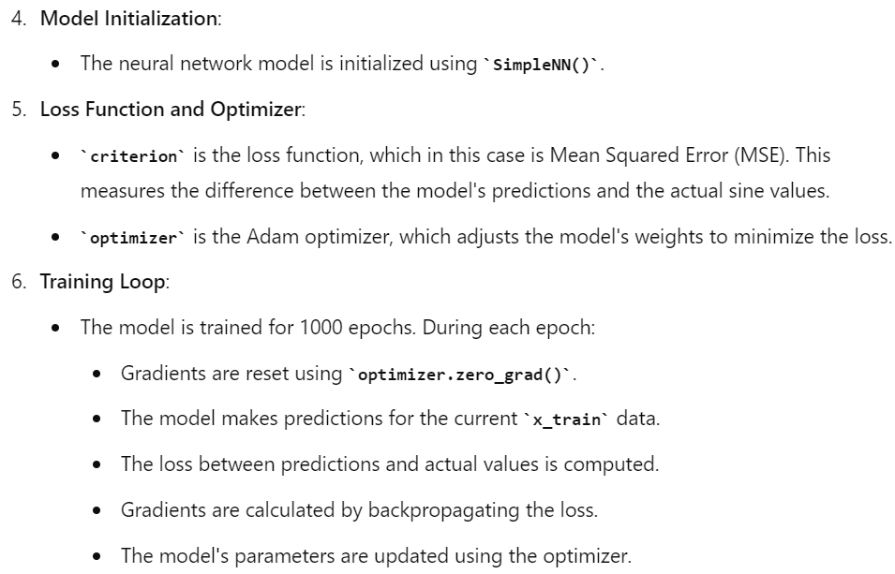
SINE WAVE WITH GENERATIVE MODEL

Slide 5
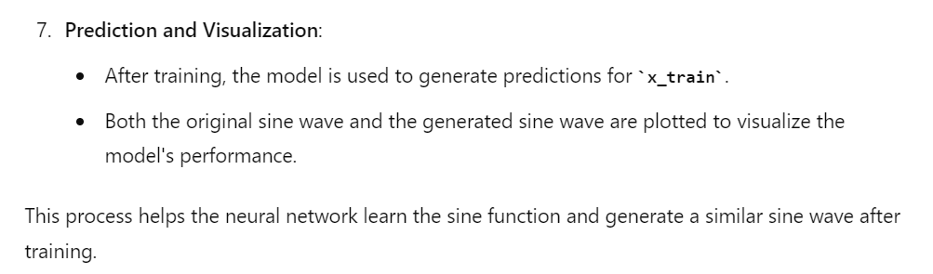
SINE WAVE WITH GENERATIVE MODEL

Slide 6
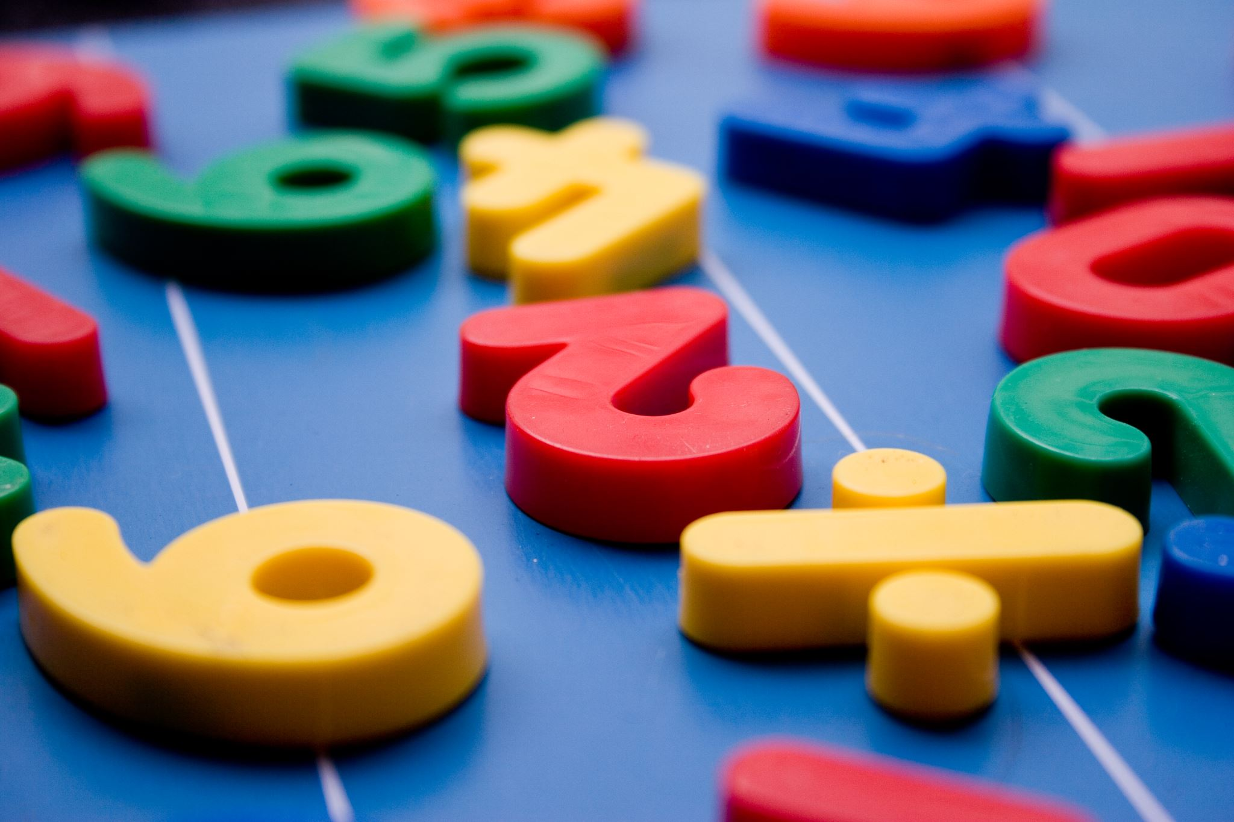
AUTOENCODER FOR
IMAGE
RECONSTRUCTION

Slide 7
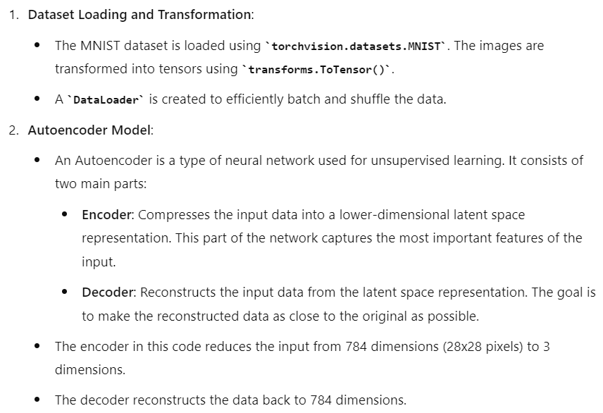
AUTOENCODER FOR IMAGE RECONSTRUCTION

Slide 8
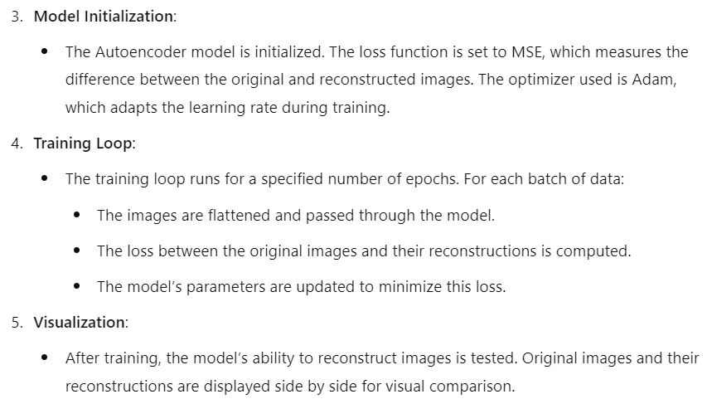
AUTOENCODER FOR IMAGE RECONSTRUCTION

Slide 9
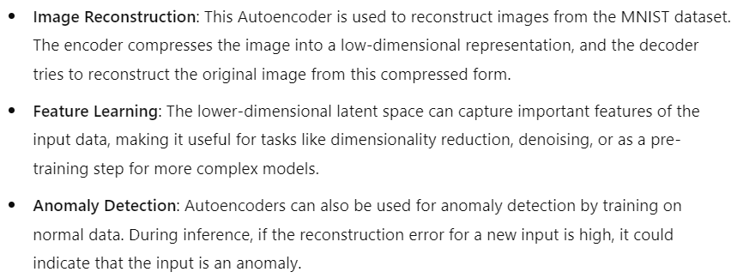
VALUE ADDS - AUTOENCODER FOR IMAGE RECONSTRUCTION

Slide 10
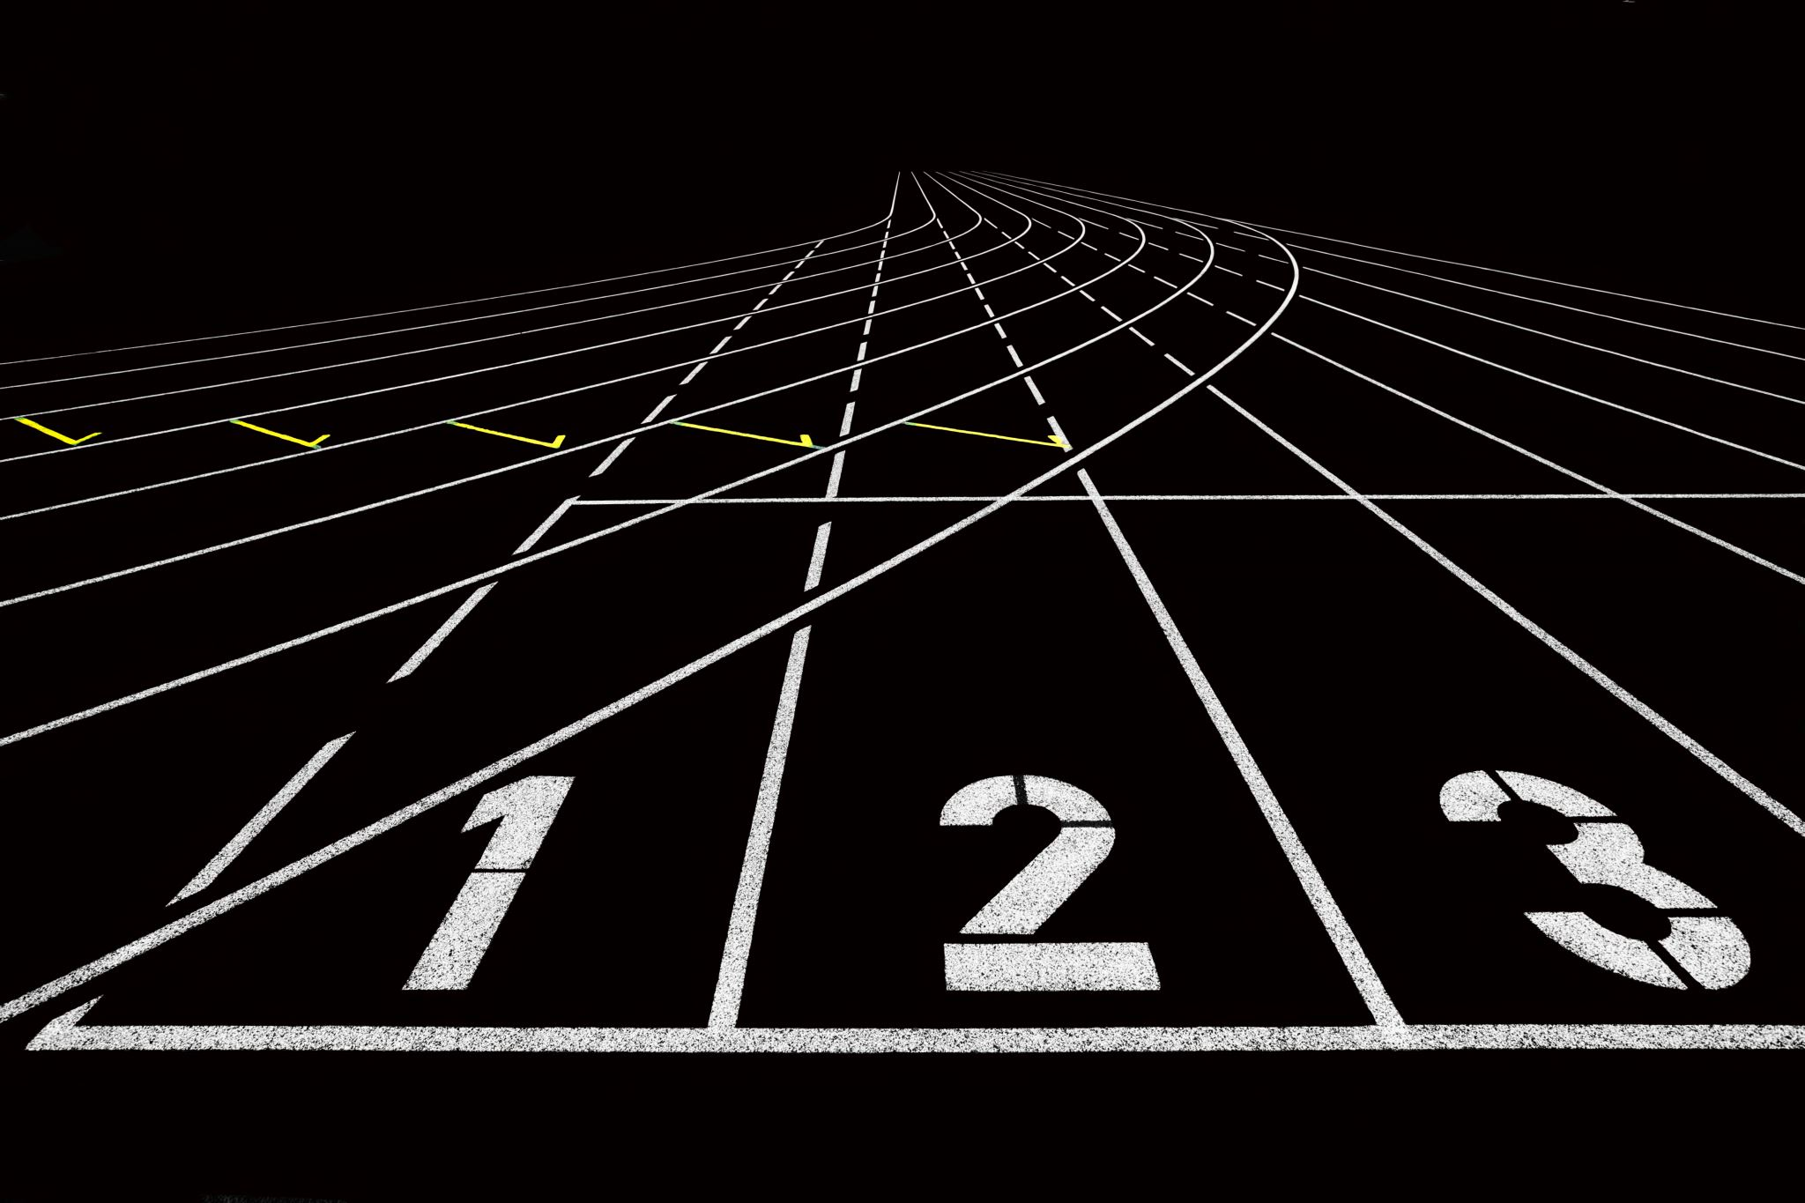
GAN
TO GENERATE
DIGITS

Slide 11
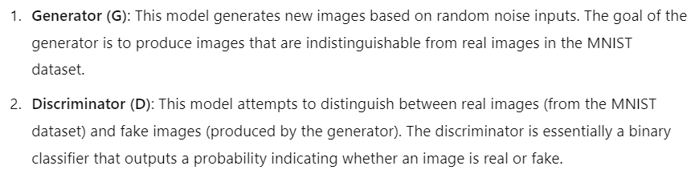
GAN TO GENERATE DIGITS

Slide 12
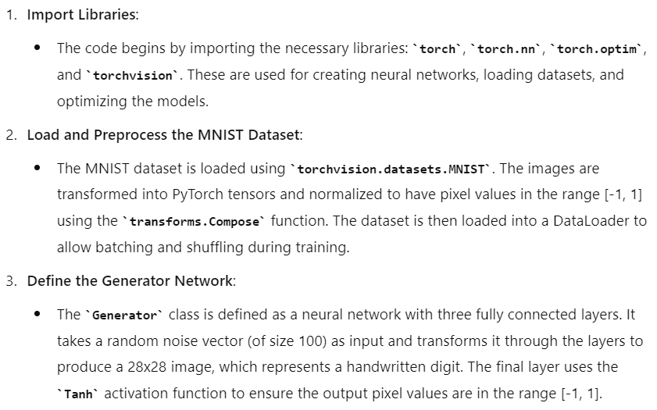
GAN TO GENERATE DIGITS

Slide 13
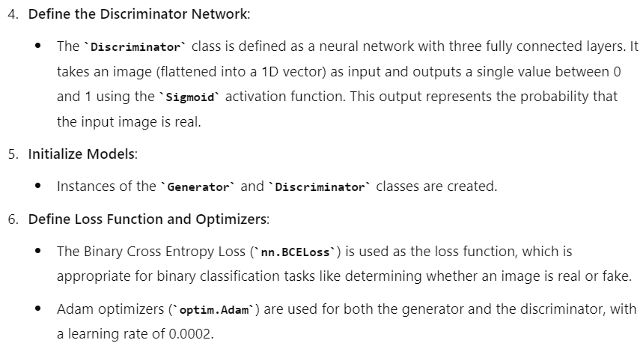
GAN TO GENERATE DIGITS

Slide 14
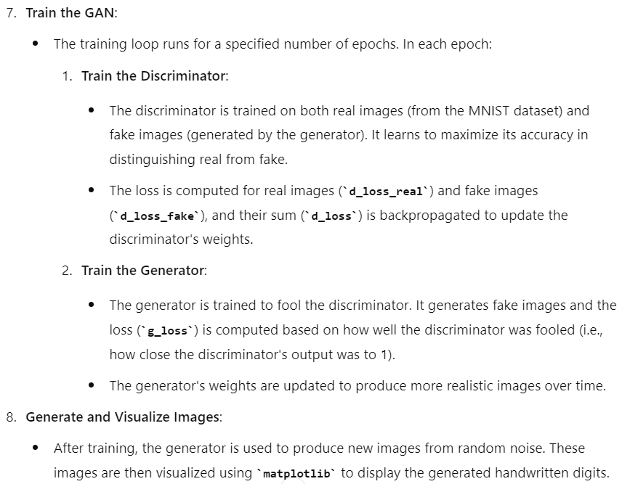
GAN TO GENERATE DIGITS

Slide 15
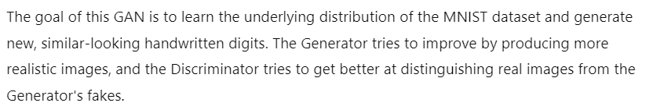
VALUE ADDS - GAN TO GENERATE DIGITS

